Slide 1
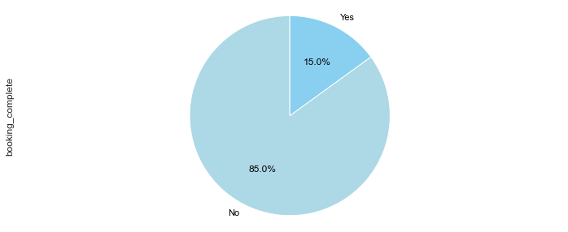
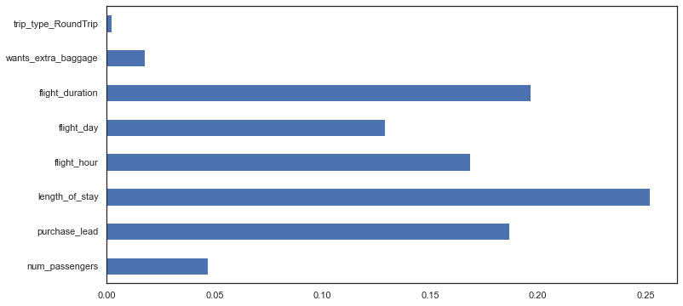
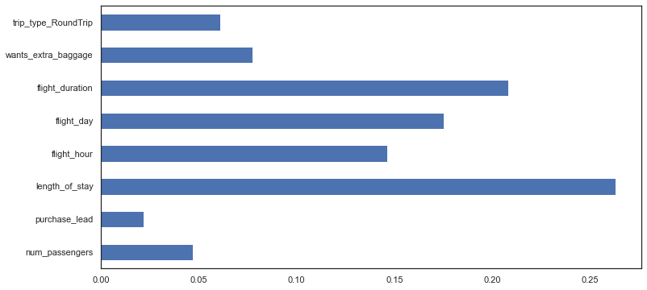
Building a ML model for predicting an outcome of customer making a booking
So the first task was to do some pre-processing and performing EDA on the dataset. From the pie chart we can see that it is an imbalanced dataset. So we employed 4 classification models viz. Logistic Regression, Random forest, XGBoost classifier and KNearestNeighbour. None of the models could provide an acceptable recall score for the minority class(1). So we had to apply SMOTE technique. And finally after performing feature engineering we could build a good predictive model with XGBoostClassifier with an overall accuracy of 91%, with around 99% precision for class(1), and recall of 82% and 99% for class(1) and class(0) respectively.
RandomForest model important features
XGBoost model important features

